Slide 1
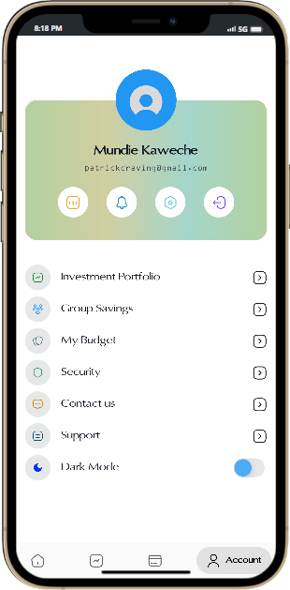
Unified Banking Interface & Decentralized credit scoring analysis
By Mundie Kaweche
Engineering in Computer Science
Guide: Mr. Pempho Jimu

Slide 2
Problem statement
The current financial system in Malawi often excludes marginalized and underserved populations, leaving them vulnerable to economic shocks and hindering their ability to improve their financial well-being. Limited Access to Credit: A substantial portion of the population in Malawi lacks access to formal credit due to the absence of reliable credit scoring mechanisms. Traditional credit scoring methods are often inadequate or inaccessible, preventing individuals and small businesses from accessing affordable credit and stifling economic growth.

Slide 3
Abstract
I present to you a FinTech system with an innovative integration of credit scoring within an advanced e-wallet platform. This system caters to both urban professionals and rural communities, offering an easy fast payment mechanism and seamlessly linking it with creditworthiness evaluation. By enabling users to pool their funds from their different banks in a shared digital space, the system promotes financial inclusion. Moreover, it incorporates a sophisticated credit scoring algorithm that analyzes users' activities and financial behaviors thereby facilitating easy loan access through blockchain technology, the system ensures unparalleled transparency, enhancing the efficiency and reliability of loan acquisition processes for all users.

Slide 4
Objectives
Enhance Financial Inclusion
Improve Credit Accessibility
Foster Community Financial Empowerment:
Promote Financial Literacy
Ensure Data Security and Privacy
Measure and Evaluate Impact

Slide 5
Literature Review
Author | Year | Title of Study | Objectives | Disadvantages
Standard Bank’s digital platform business | 2021 | UNAYO | Unayo offers a boundless new value proposition focusing on digital innovation, accessibility and solves for the last mile in remote villages | Only accessible to a standard bank customers Doesn’t account for creditworthiness Doesn’t Support UPI
BankNet 360 | 2019 | Mo626 | Customer access to account 24 hours a day, 7 days a stage An efficient self-service channel for all basic account transactions Safe and secure through the use of two factor authentication Allows customer self on-boarding | Only accessible to a national bank customers Creditworthiness is only for the natbank users Doesn’t Support UPI

Slide 6
Literature Review
Tnm and Airtel | 2013 | Mpamba/Airtel money | Send and receive money across networks Top up your Phone and your Friend's Phone via Airtel Money/ mpamba Make Payments using airtel money (utility bills, goods & services) Bank transactions (check bank balances, send money from your phone to your bank & from your bank to your phone or to another bank account.) | Only Merchants account for creditworthiness Doesn’t Support UPI These are independent systems at most parts
First Discount House | 2022 | Fdh mobile | FDH Bank mobile banking solution allows you to perform your banking functions. You can view your account balances, statement, perform transfers, buy airtime. | Only accessible to a fdh bank customers Doesn’t account for creditworthiness Doesn’t Support UPI
wealthNet | 2021 | Kaku gateway | Bank transactions (check bank balances, send money from your phone to your bank & from your bank to your phone or to another bank account.) | Doesn’t account for creditworthiness Doesn’t Support UPI

Slide 7
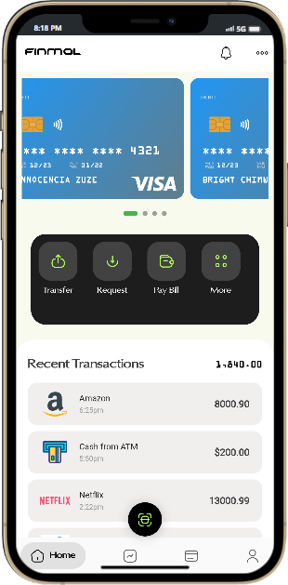
Module Description
User Management Module
Credit Risk Model:
Blockchain Integration Module:
Banking Services Integration Module:
Security and Compliance Module:

Slide 8
Tools
Block-chain Development Frameworks:
Database Management Systems (DBMS):
Web/Mobile App Development Frameworks:
Data Analytics Tools:
Security Tools

Slide 9
Algorithms
Credit Scoring Algorithm(Random Forest Classifier)PH, LOC,CUA
Block-chain Algorithms Consortium Blockchain
Encryption Algorithms tokenization AES

Slide 10
Methodologies
Decile Methodology
User-Centered Design (UCD)
Security-First Approach

Slide 11
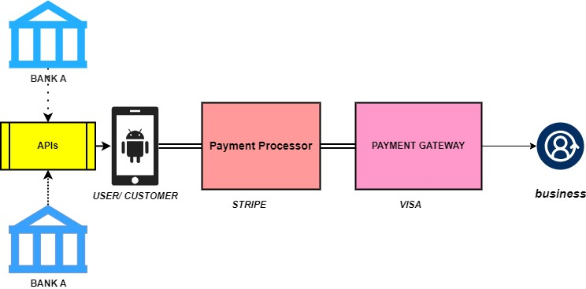
System Architecture

Slide 12
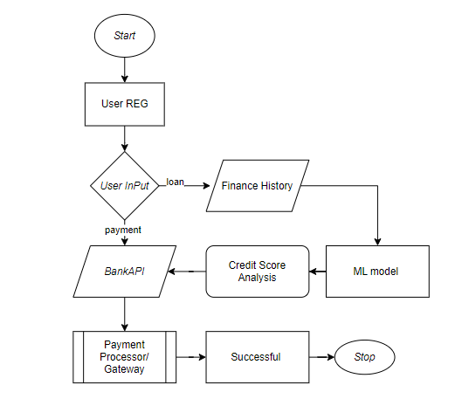
Data Flow Diagram

Slide 13
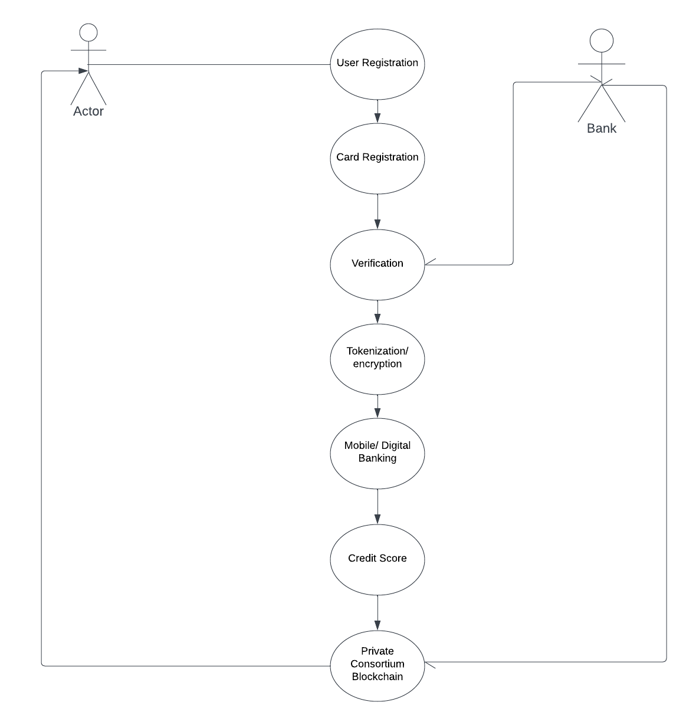
Use Case

Slide 14
Input design
User Credentials
Add Bank Info
Push Actions
Request Loan
Credit Analysis/ Valid Detection
Authenticate

Slide 15
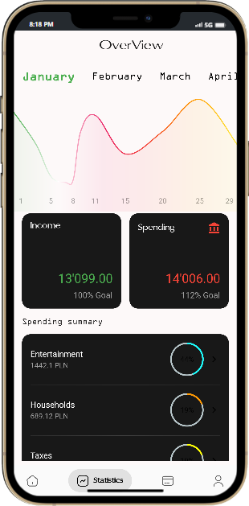
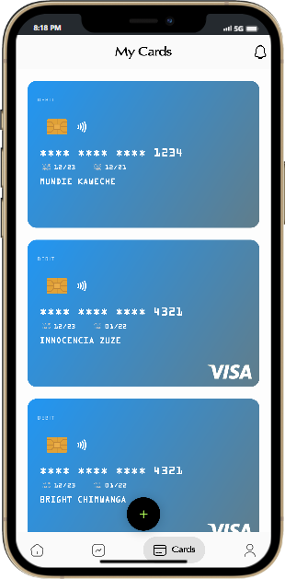
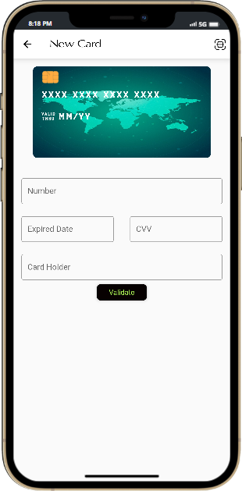
Implementation

Slide 16
Thanks for Listening

